Slide 1
CHINA
TRANSFORMING ITSELF

Slide 2
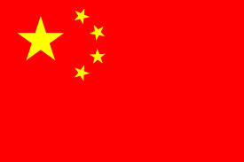

Slide 3
KEY TERMS
RADICAL:
extreme
RED GUARDS:
group of students who carried out Mao Zedong’s policies during the Cultural Revolution
FREE ENTERPRISE SYSTEM:
an economic system in which people can choose their own jobs, start private businesses, own property and make a profit.

Slide 4
GROSS DOMESTIC PRODUCT:
the total value of all good and services produced in an economy.

Slide 5
In 1985, the total number of cars, buses and trucks in all of China was about 320,000.
Most people in cities rode bicycles or walked to get around.
In 2005, the number of vehicles had grown to about 25 million.
China is growing economically.

Slide 6
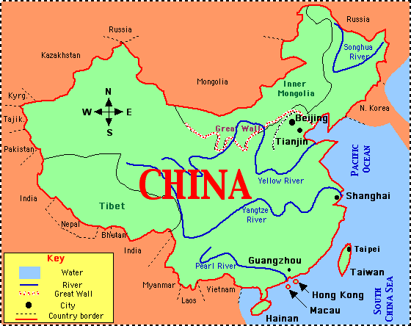

Slide 7
CHINA’S ECONOMY, 1949-1980
During the government of Chinese Communist party leader Mao Zedong, the government took over the Chinese economy.
Factories, businesses and farmland came under the government’s control.

Slide 8
THE GREAT LEAP FORWARD
In 1958, Mao began a radical or extreme program called the “Great Leap Forward”.
Its goal was to increase output from farms and factories.
This program turned out to be a giant step backward.
They started forcing the people to work on communes without any experience or planning.
As a result the crops and the products from the factories were of poor quality and useless.

Slide 9
At the same time poor weather destroyed the crops resulting in a severe food shortage and almost 30million people died from starvation.

Slide 10
THE CULTURAL REVOLUTION
In 1966, Mao introduced another radical policy called the Cultural Revolution.
His aim was to start a completely new society with no connection from the past. He started this by closing the schools and forcing students to rebel against teachers and families.
The students formed bands of radical called Red Guards.

Slide 11
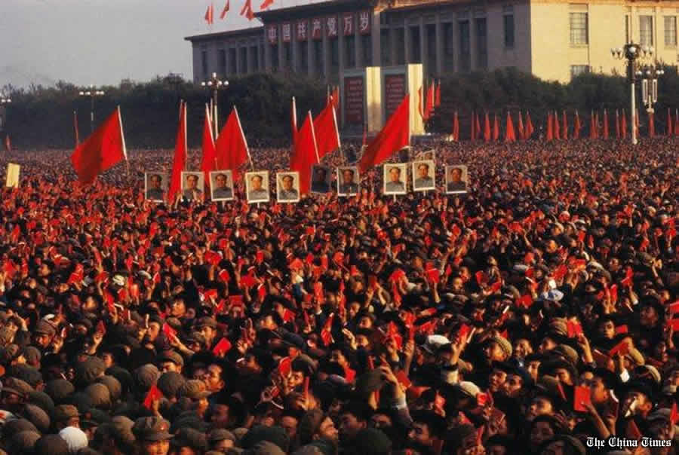

Slide 12
These bands destroyed many ancient buildings in China.
They beat and imprisoned many Chinese artists, professors and doctors. Anyone they considered against Mao’s policies was attacked.
The Red Guards became out of control and was a threat to Mao’s government, so he imprisoned them too.
Hundreds and thousands of people died and China’s economy weakened.

Slide 13
CHINA’S GOVERNMENT
The government was a dictatorship.
In this type of government, the power is held by one person.
A dictator has control over nearly everything people do.
Dictator Mao Zedong was the dictator of China from 1949 to 1976.

Slide 14
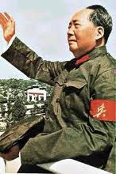

Slide 15
TAIWAN SINCE 1949
Communist defeated the Nationalists so they fled to Taiwan, an island 100 miles off the mainland China.
They formed a new government and called their country Republic of China.
The Communists still claimed the right to rule Taiwan. Similarly the Nationalists also want to control the rest of China.

Slide 16
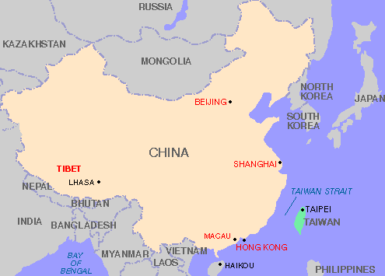

Slide 17
The Nationalists chose free enterprise system in their country which became the strongest economy in Asia.
This brought more money in the country which helped in making the new ports and railroads.
Exports of Taiwan grew, which helped in the growth of their economy.

Slide 18
CHANGES IN CHINA
During the dictatorship in China, many western countries refused to trade with China.
In 1970s they realized that they need new policies to improve.
China started improving its relations with the West first.
In 1971, China was allowed to join the United Nations.
In 1972, Richard Nixon was the first American President to visit China. It opened new trades between the two nations.

Slide 19
NEW LEADERS
After Mao died in 1976, moderate leaders gained power in China.
Deng Xiaoping carried out a program called the Four Modernizations.
This program focused on improvements in farming, industry, science and defense.
Gradually they allowed some free enterprise.

Slide 20
NEW ECONOMIC PLANS
Deng allowed foreign companies to set up their businesses.
It helped to bring in money to the Chinese economy.
By the end of 1990s private businesses were producing about 75 % of the gross domestic products.

Slide 21
HONG KONG RETURNS TO CHINA
In 1997, China took back control of Hong Kong, which has been a British colony since 1800s.
China agreed to allow Hong Kong with no major changes in governing itself.

Slide 22
CHINA TODAY
Today China is a powerful country and has good relations with many nations.
Still the people do not have political freedom as the government uses violence against people who want a democratic government.
In 1989 thousands of people gathered in Tiananmen Square in Beijing to demand political freedom.

Slide 23
The government sent tanks and troops, as a result thousands were killed or wounded.
China manufactures many items for other countries.
Due to huge population people willingly work on low wages for as long as 18 hours continuously.

Slide 24
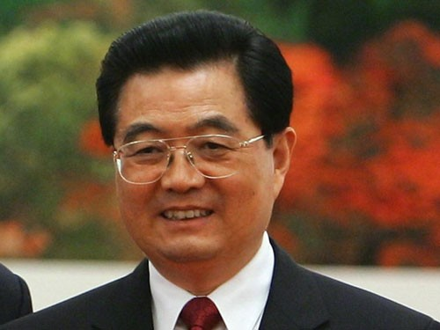
Xi Jinping is the current president of China.

