Slide 1
PAKISTAN
AN ECONOMY BASED ON AGRICULTURE

Slide 3
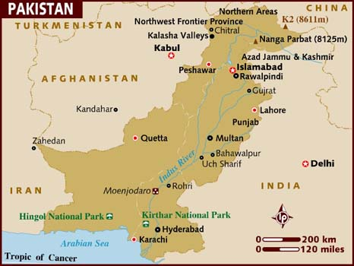

Slide 4
MAMNOON HUSSAIN

Slide 5
KEY TERMS
DROUGHT:
a long period of dry weather.
GREEN REVOLUTION:
a worldwide effort to increase food production in developing countries.
SELF-SUFFICIENT:
able to supply one’s own needs without any outside assistance.
TRIBUTARY:
a river that flows into a larger river.

Slide 6
Rainfall is scarce throughout much of Pakistan.
Pakistan’s water supply includes three main sources: The Indus River, Monsoon Rains, and slow-melting glaciers.
Pakistan has built the World’s largest irrigation system to make the most of this precious water.
In 2001, Pakistan was in the middle of an extreme brought. The government was so much concerned that they considered that they were thinking about melting the glaciers in the northern part artificially.

Slide 7
One way to melt was to spray charcoal, which would raise the temperature of the ice and it will melt.
Later that year the government gave up this plan due to the environmental concerns.

Slide 8
AN AGRICULTURAL NATION
Pakistan’s economy is based mainly on agriculture.
That is why water is the most important thing for the economy of Pakistan.

Slide 9
FARMING
Most of the farming takes place near the River Indus, where the irrigation system is located.
Cotton, wheat, rice are grown there.
Pakistan is among the top ten producers of cotton.
Rice farmers grow enough rice to be exported to other countries.
Wheat is the major food crop in Pakistan.

Slide 10
The Green Revolution has helped farmer’s to grow more wheat, which started in 1940s.
This program introduced modern farming methods and special varieties of wheat, rice, and corn.
In 2000 Pakistan had enough wheat to export to countries like Afghanistan etc.
Becoming self-sufficient in wheat was one of the goals of the government.

Slide 11
MANAGING THE WATER SUPPLY
Pakistani farmers use many canals and ditches to move water from the River Indus to their farms.
In this way they have a steady supply of water all year round, even in drought condition.
As more water is being supplied more crops are being produced.

Slide 12
Irrigation has solved many farming problems but it creates others too.
For example: river water contains small amounts of salts. When water evaporates the salt is left behind. Over time salts build up in the soil that slows the plant growth.
Pakistani scientists are trying to find a way to treat the salt-damaged soil.
They are also working to develop a type of wheat that can grow in salty soil.

Slide 13
Pakistanis have another water problem, one that is the opposite of drought.
During the monsoon season, damaging floods can occur. One solution is the large dams built by the government.
The dams catch and hold monsoon rains.
The waters are then released as needed into irrigation canals.

Slide 14
INDUSTRY IN PAKISTAN
Dams such as Tarbela, not only help the farmers but they also capture the energy of rushing water to create hydroelectricity.
In Pakistan, hydroelectricity power plants produce electricity to run textile mills and other factories.
Most industry is located near the sources of hydroelectric power, on the plains of the Indus River.

Slide 15
INDUSTRY BASED ON AGRICULTURE
Pakistan began its growth in industry by building on what its people knew best: agriculture.
Today Pakistan’s industry depends mainly upon textile industry.
More than 60% of the exports come from the textile industry.
Textile products include yarn, cloth and garments made form cotton grown by the farmers.

Slide 16
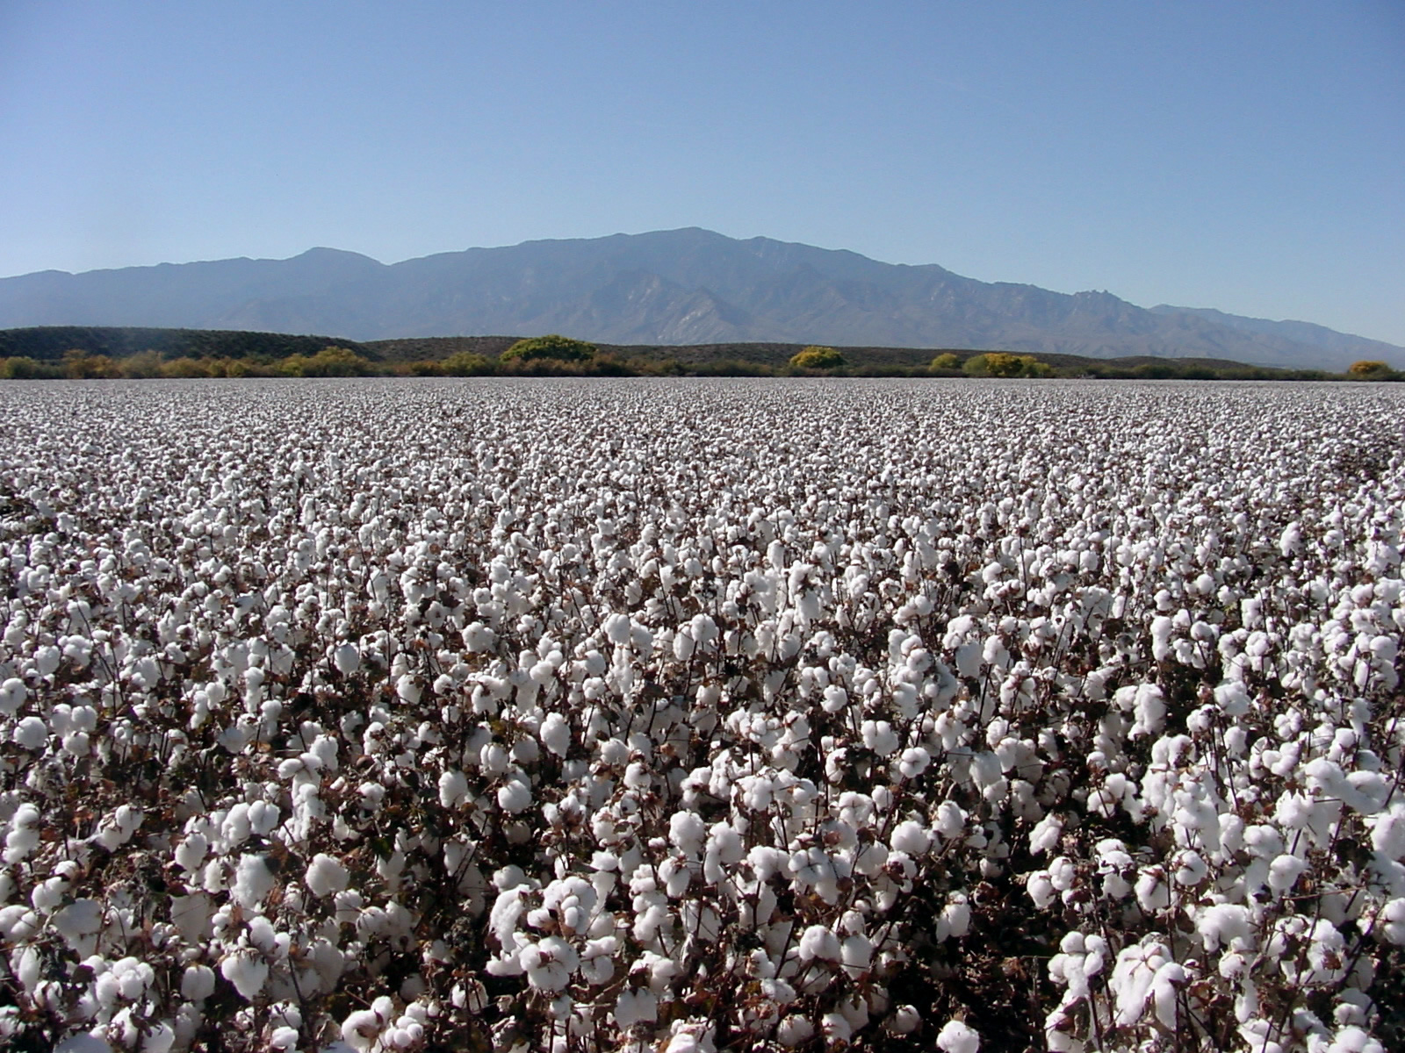

Slide 17
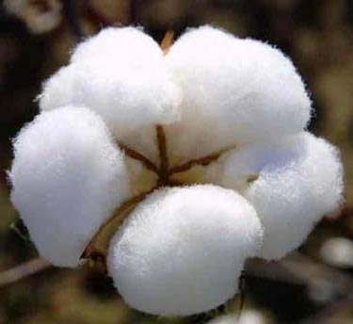

Slide 18
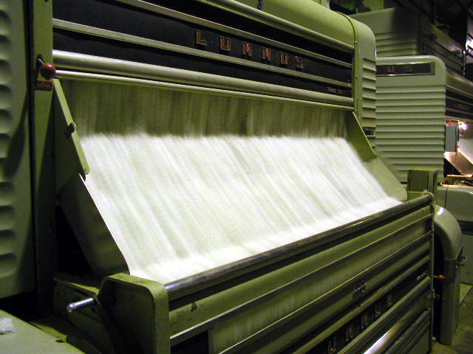

Slide 19
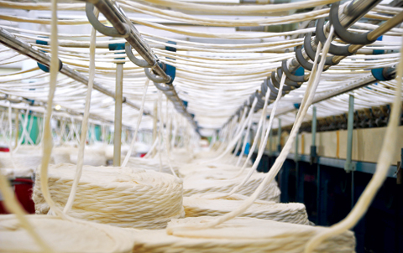

Slide 20
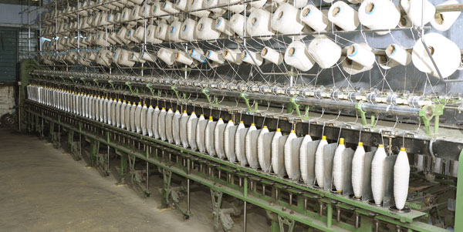

Slide 21
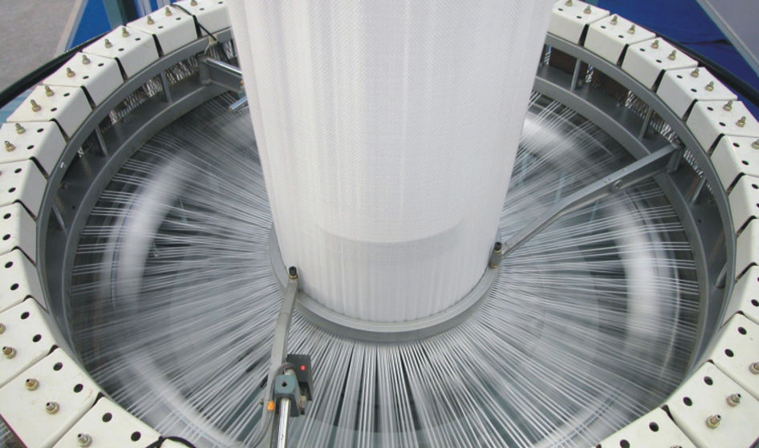

Slide 22
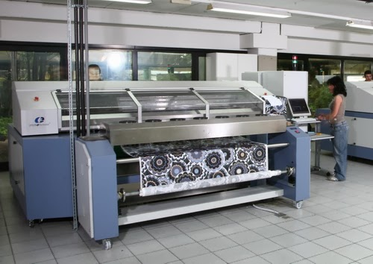

Slide 23
OTHER INDUSTRIES IN PAKISTAN
Pakistan has other industries too such as chemical industries that produce paint, soap, dye, insect killing sprays.
Pakistan uses its natural resource, limestone, to make cement.
Pakistan has steel mills too.
Pakistan has skilled workmen who make hockey sticks, furniture, knives, saddles and carpets.

