Slide 1
SOUTHEAST ASIA
CULTURES AND HISTORY

Slide 2
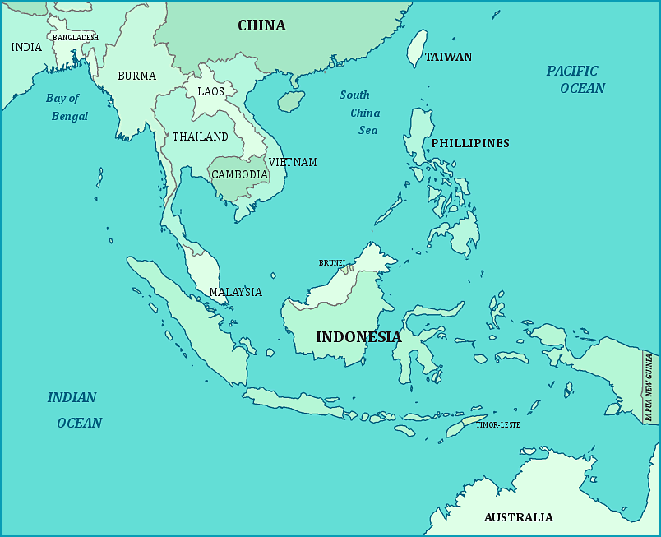

Slide 3
KEY TERMS
KHMER EMPIRE: an empire that included mush of present-day Cambodia, Thailand, Malaysia and part of Laos.
NATIONALIST: a person who is devoted to the interests of his or her country.
KHMER ROUGE: the Cambodian Communist party.

Slide 4
ANGKOR WAT
It is the largest Hindu temple I the world which is located deep in the rainforest of Cambodia.
It was built by the Khmer Civilization in 1100 A.D. with stones.
The Khmer Empire was one of many kingdoms in Southeast Asia.

Slide 5
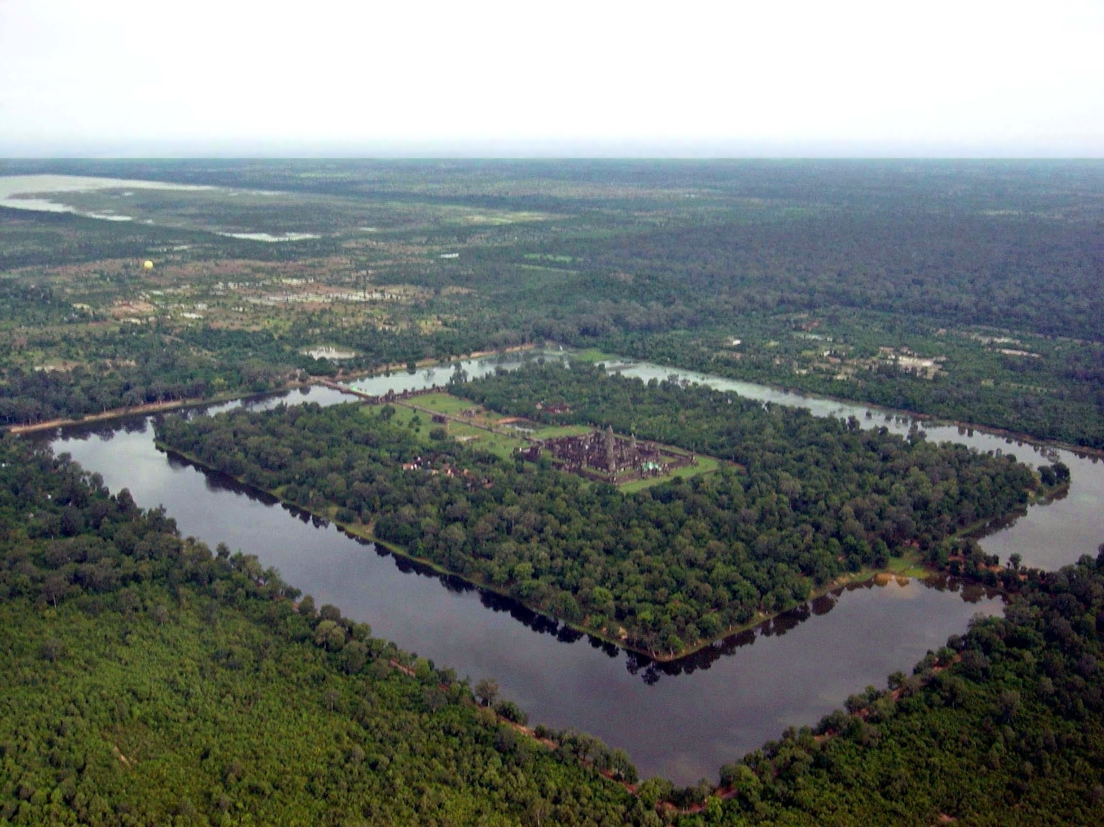

Slide 6
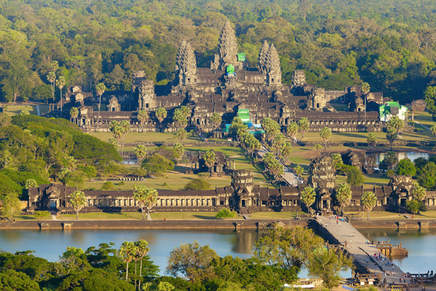

Slide 7
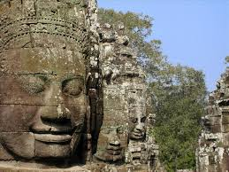

Slide 8
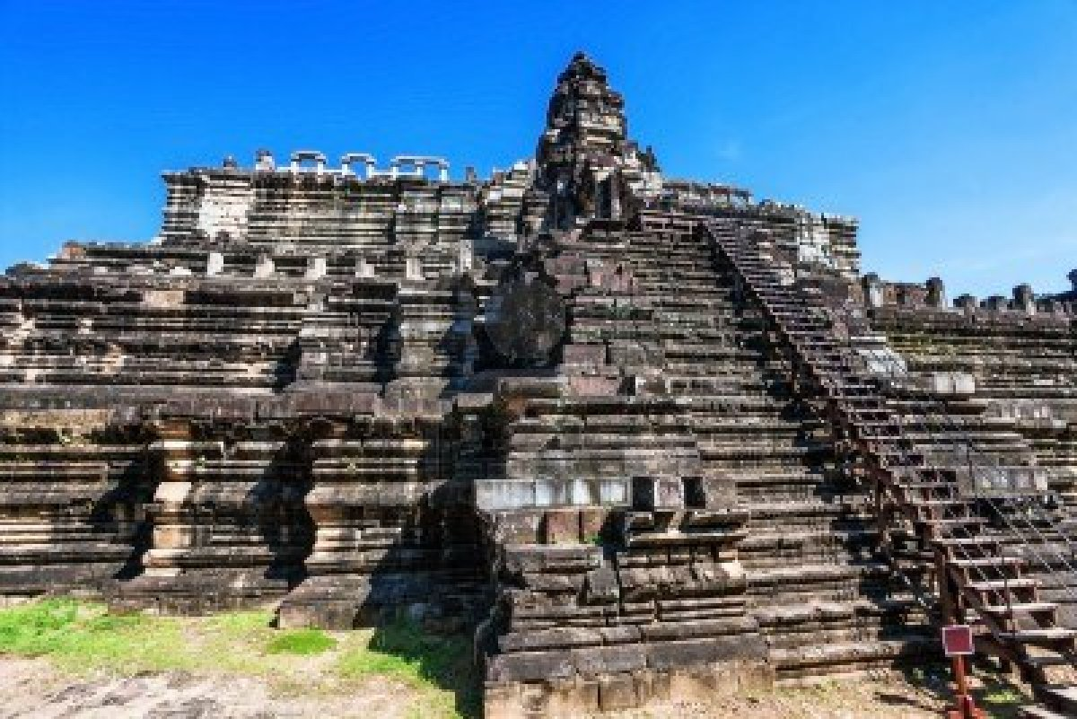

Slide 9
A REGION OF DIVERSITY
Southeast Asia’s mountains kept groups of people apart from one another. As a result, each group developed its own way of life.
Later outsiders came from mainly India and China because Southeast Asia is located between them. As a result their culture was strongly affected by them.

Slide 10
IMPACTS OF INDIA AND CHINA
India affected their culture mainly due to trade.
2000 years ago Indian traders sailed across the Indian Ocean and introduced the religion of Hinduism to the region.
Later they brought Buddhism too.
Long after Hinduism and Buddhism, Indians brought Islam to Southeast Asia, from where it was carried to Indonesia and Philippines.

Slide 11
China’s effect was felt mainly in Vietnam as the Chinese conquered it.
The Chinese ruled the country for more than 1000 years.
During that time, the Vietnamese began using way of farming.
They also began using the ideas of Confucius, the ancient Chinese philosopher.

Slide 12
MAJOR RELIGIONS OF SOUTHEAST ASIA
Today there are Hindus in Indonesia and Malaysia, but Buddhist and Muslims are even more.
Buddhism is the main religion in Myanmar, Thailand, Laos, Vietnam and Cambodia.
Islam is the main religion in Indonesia and Malaysia.
Indonesia has the largest Muslim population in the World.
Singapore has a mix of religions that include Muslims, Buddhists, Hindus and Christians.
Most of the people in Philippines are Christians.

Slide 13
COLONIAL RULE IN SOUTHEAST ASIA
Europeans brought Christianity to the region.
The European traders hoped to take the control of the rich trade in silks, iron, silver, pearls and spices.
Portugal, Netherlands and other European countries took control over the region.
Thailand was the only country that was not under the colonial rule.
Thailand was known as Siam until 1939.

Slide 14
EFFECTS OF THE COLONIAL RULE
Colonial rulers built bridges, roads, ports and railroads in Southeast Asia. Due to which moving from city to city became easier.
The colonial powers also built schools, which helped to produce skilled workers for industries.
Education gave them skills to become teachers, doctors, government workers and more.

Slide 15
THE ROAD TO INDEPENDENCE
By the time World War II broke in 1939, Japanese began coming to this region.
The Japanese drove the colonial forces out of the region.
Japan got defeated in World War II, and so the nations gained their independence.
Philippines and Burma got their independence peacefully.
Laos, Cambodia, Vietnam, Malaysia and Indonesia had to fight for it.

Slide 16
VIETNAM, CAMBODIA AND LAOS
Gaining independence was not easy for these countries.
They were under the control of France.
When Japan got defeated in World War II, in 1945 France tried to get the control back, but the Vietnamese fought against the French.
In 1954, they forced France to leave.

Slide 17
THE VIETNAM WAR
When the Vietnamese defeated France, they wanted to be a Communist country.
United States was not in the favor of Communist government and tried stopping it, whereas Soviet Union, its rival, wanted to spread it.
As a result in 1954, Vietnam was divided into two parts. North Vietnam is Communist while South Vietnam is non-Communist.
North Vietnam tried to join the country but US helped South Vietnam to fight back.
After years of fighting US army was forced out and now the country in united under a Communist government.

Slide 18
CAMBODIA AND LAOS
In 1953 the two countries gained their independence from France, but were under the influence of the Vietnam war.
United States bombed Cambodia and Laos to destroy the North Vietnam forces there.
In 1975, Khmer Rouge took over and forced the people to work in fields. Over the next four years they killed more than a million people.

Slide 19
In 1998 Khmer Rouge leader, Pol Pot was killed and they surrendered.
The country became more stable under a coalition government formed in 2004.

