Slide 1
THE STANS
A DIVERSE REGION

Slide 2
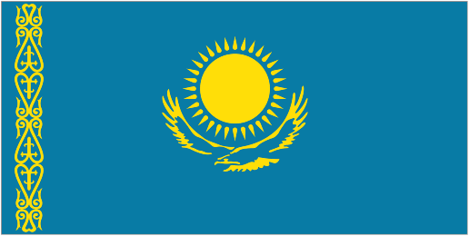
FLAG OF KAZAKHSTAN

Slide 3
FLAG OF UZBEKISTAN

Slide 4
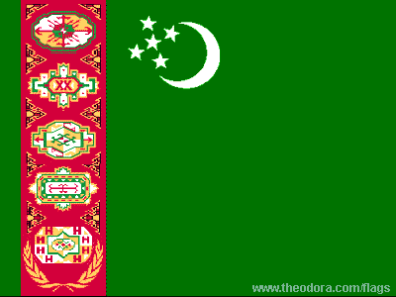
FLAG OF TERKMENISTAN

Slide 5
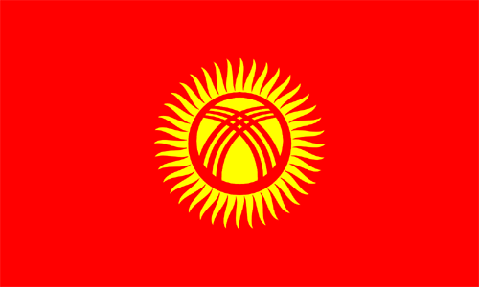
FLAG OF KYRGYZSTAN

Slide 6
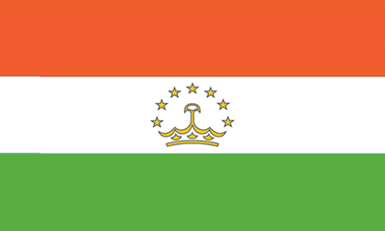
FLAG OF TAJIKSTAN

Slide 7
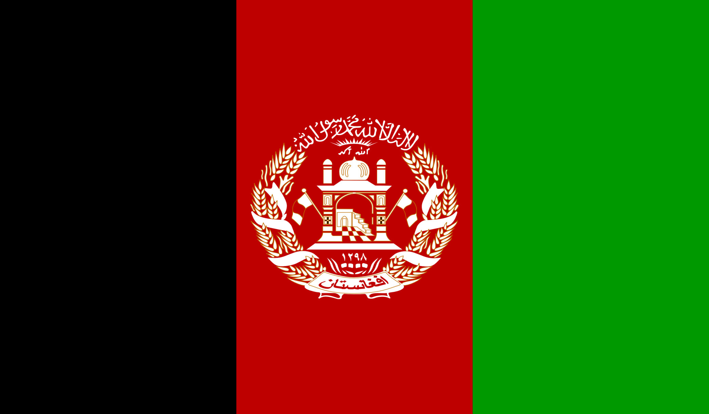
FLAG OF AFGHANISTAN

Slide 8
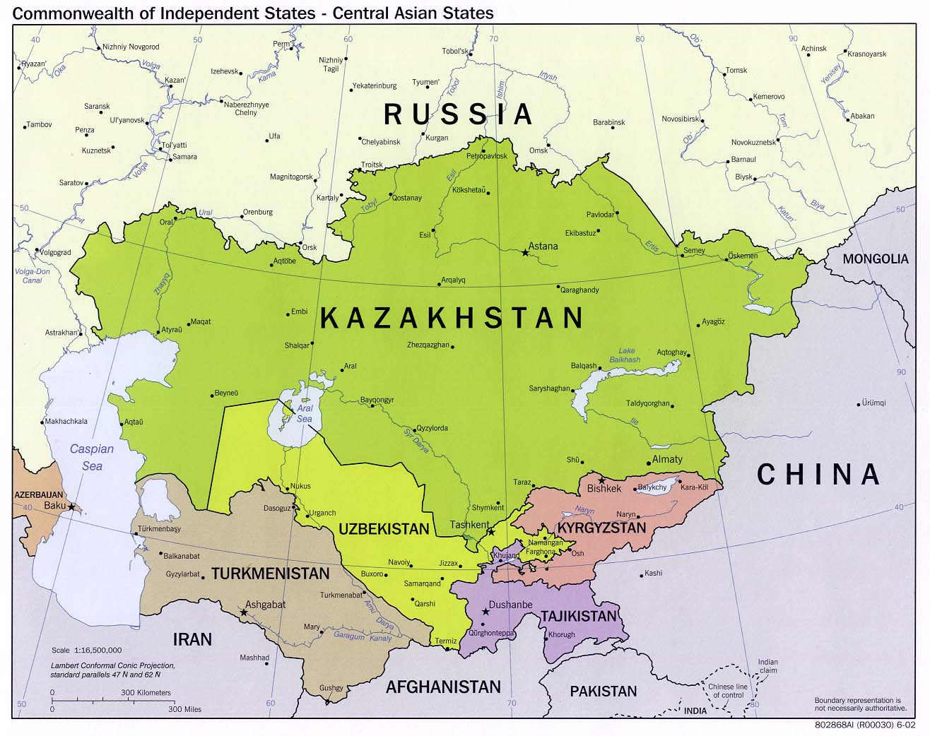

Slide 9
THE STANS
REFUGEE:
a person who flees war or other disasters.
DICTATORSHIP:
a form of government in which power is held by a leader who has absolute authority.
LANDLOCKED:
having no direct access to the sea.

Slide 10
Soviet Union invaded Afghanistan in 1979 when Sharbat Gula was just a child.
She had to face the hardships of war. Her village was destroyed and parents were killed.
She fled to Pakistan where she lived in a refugee camp.
In 1985, a photographer named, Steve McCurry took her picture and managed to trace her back to her village in Afghanistan.
She was married and had kids and hope that her ids could get better life and opportunities than her.

Slide 12
WARFARE AND UNREST IN AFGHANISTAN
The war lasted for 10 years, until in 1989, the Soviet withdrew its forces.
But that was not the end of the fighting in Afghanistan.

Slide 13
CONFLICT IN AFGHANISTAN
A group of militant Islamic people called the Taliban gained power in Afghanistan in 1996.
Taliban established very strict Islamic rule. It limited freedoms and executed or severely punished those who violated their laws.
Girls were not allowed to attend school and women were not allowed to work outside the house.
Television, music and internet were banned.

Slide 14
The Taliban were supported by the extreme Muslims from the other countries.
One of these supporters was Osama bin Laden, a wealthy Saudi Arabian who moved to Afghanistan.
In 1996, Taliban placed Osama bin Laden under its protection.

Slide 15
A CAMPAIGN AGAINST TERRORISM
Osama bin Laden was the leader of Al-Qaeda, a terrorist group.
He was the leading suspect in the attacks of September 11, 2001, that destroyed the World Trade Center in New York, damaged the Pentagon in Washington D.C., and killed nearly 3,000 people.

Slide 16
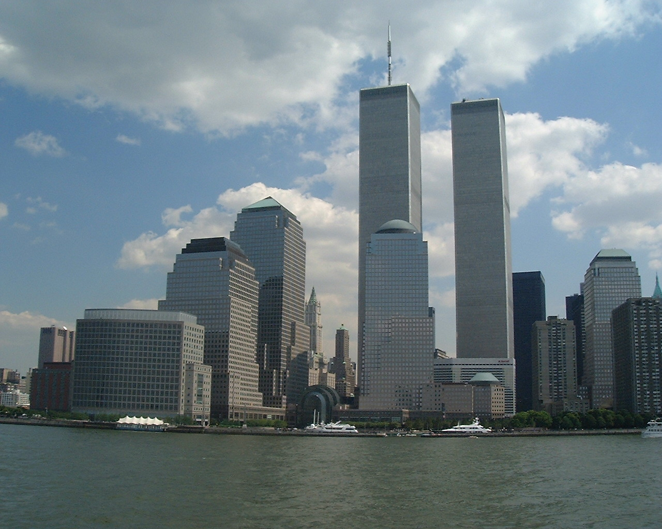

Slide 17
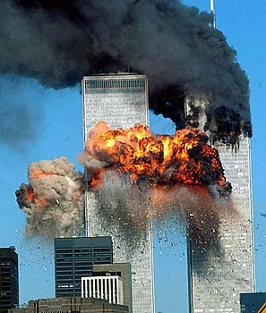

Slide 18
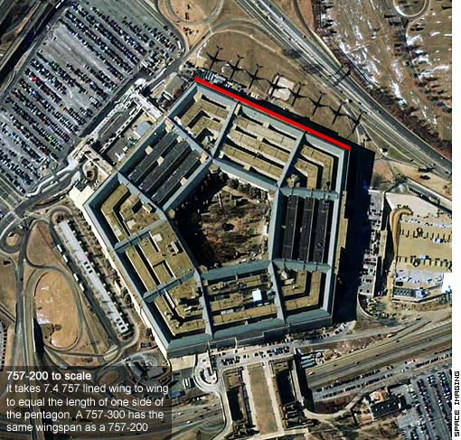

Slide 19
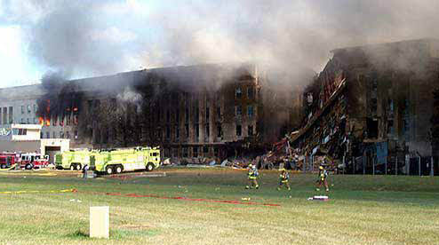

Slide 20
Taliban refused to hand over bin Laden to the United States, so American troops invaded Afghanistan in October, 2001.
Americans quickly over threw the Taliban government.
Since that time Afghanistan has had a democratic government and in 2004, Hamid Karzai became the first democratically elected president.

Slide 21
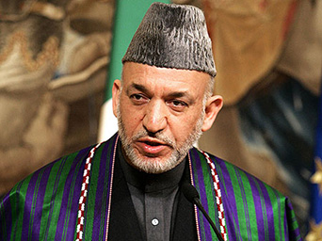

Slide 22
HERAT, AFGHANISTAN
Herat, a city in Afghanistan was a center of Afghan culture and learning.
When Taliban took control of Herat in 1995, they made it a crime to educate girls and women.
Professors form the universities and members of the literary circle risked their lives to help women continue the study.
Thousands of girls were taught in hiding during the Taliban rule.

Slide 23
CONFLICTS IN OTHER CENTRAL ASIAN COUNTRIES
Afghanistan was not the only Central Asian country to experience conflict.
Tensions among rival leaders, clans, and ethnic groups also affected other countries in the region.

Slide 24
ETHNIC DISPUTES
Central Asia is a mixture of various ethnic groups and cultures.
For many years, strong Soviet rule kept ethnic and clan tensions under control.
As Soviet rule came to an end, these tensions increased.
In Kazakhstan, for example, disputes between Kazakhs and Russians over political and economic issues became stronger and stronger.

Slide 25
POLITICAL CONFLICTS
The situation in Tajikistan was worse.
A bloody civil war started and left the country in ruins.
In Uzbekistan, conflict started in the Ferghana Valley. This fertile valley came under attack from radical Muslim groups.
They wanted to overthrow the government of Uzbekistan and found as Islamic state.

Slide 26
Due to continuous political disturbance most of the countries went under dictatorship.

Slide 27
HELP FOR CENTRAL ASIA
United States and other Western countries were against the dictatorship rules.
They helped the region to create a democratic government.
They provided training, equipment and money $594 million in 2002 to build its economy.
They utilized some of this money to train judges in Kyrgyzstan and Tajikistan.

Slide 28
ECONOMIC CONDITIONS IN CENTRAL ASIA
The Stans are generally poor countries.
Agriculture is the main source of economy, although mining, manufacturing and energy production are also important.
They are also working to grow their industries.

Slide 29
AGRICULTURE
Agriculture is the main source of their income. During the Soviet rule large cotton farms produced huge amounts of cotton for export.
Cotton farming is still very important especially in the Ferghana Valley, but other types of farming have also increased.
Some farms in Central Asia are large like the cotton farms in Uzbekistan, but most are small.
For most small farmers life is a struggle. They just produce enough to feed their own family.

Slide 30
Sharbat Gula’s life is very modest.
Her village lies in the hills of eastern Afghanistan.
Villagers plant small plots of corn, wheat and rice on terraces built into hillsides.
They may also have a few walnut trees and may be a sheep or two.
To make money, her husband works at a bakery in a nearby city.
He makes less than a dollar a day which is not enough to buy the things for her family in order to survive.

Slide 31
ECONOMIES OF CENTRAL ASIAN COUNTRIES
COUNTRY | ECONOMIC ACTIVITIES
AFGHANISTAN | Farming and livestock raising. Small-scale production of textiles, furniture, cement.
KAZAKHSTAN | Farming, oil and coal mining, steel production, textiles.
KYRGYZSTAN | Farming and livestock raising. Cotton, tobacco, wool and meat.
TAJIKSTAN | Mainly farming, mostly cotton. One large aluminum plant.
TURKMENISTAN | Major cotton-producing country. Production of natural gas, oil and textiles.
UZBEKISTAN | Major cotton exporter. Large producer of gold and oil.

Slide 32
INDUSTRY
Many live in growing cities like Almaty, Kazakhstan and Tashkent, Uzbekistan.
Many people live in apartments and work in offices or factories.
Many of the industries in the Stans are from the Soviet era, but they are mostly old and not in a good working condition.
Slowly they are modernizing the industries and are focused on its energy and mineral resources.

Slide 33
Many of the Stans are rich in oil, natural gas and minerals such as coal, gold, iron ore and uranium.
Kazakhstan has major oil reserves.
Turkmenistan is rich in natural gas.
One problem is that these countries are landlocked, with no direct access to the sea. Which is a problem in transporting oil.
Plane are underway to build pipelines to carry oil and gas out of the region.

Slide 34
ENVIRONMENTAL ISSUES
In the past Soviet caused great environment damage to these countries. They newly formed countries are also facing a challenge to restore and protect the environment.
One major challenge involves the nuclear fallout. For years the Soviet Union conducted nuclear tests in northern Kazakhstan. these nuclear tests left the region with severe radiation pollution.
Radiation has caused serious health problems including cancer and birth defects. This pollution will take years and decades to clean up.

Slide 35
Another major challenge is the drying of the Aral Sea.
For years, the Soviets diverted water from rivers feeding the sea to irrigate cotton fields, as a result the sea is not drying up.
Still vast areas of Central Asia remain undeveloped and undamaged. These environmentally healthy lands are their asset.
If they can preserve them it will be an important source of income for them in the future.

Slide 36
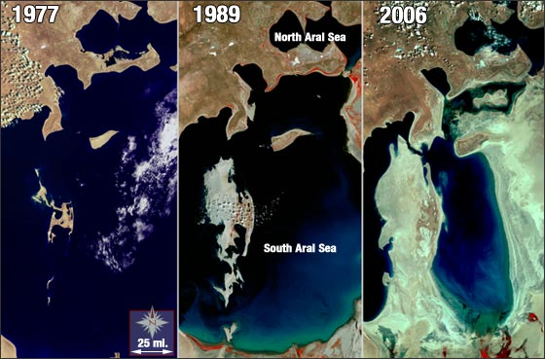

Slide 37
SAVING ART
Central Asia has a rich artistic tradition.
Many works of art has been destroyed, however as a result of war and other conflicts.
In Kabul, Afghanistan for example, the Taliban destroyed priceless art in the National Museum. They also destroyed two giant Buddha statues at Bamiyan.
Efforts are nor underway to restore or save the remaining art treasures.

Slide 38
Foreign countries and international agencies, such as United Nations, are working with the Afghan Government to preserve the country’s artistic heritage.

