Slide 1
VIETNAM
A NATION REBUILDS

Slide 2
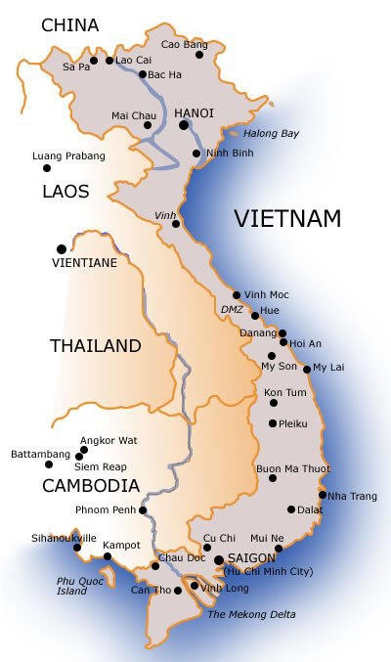

Slide 3
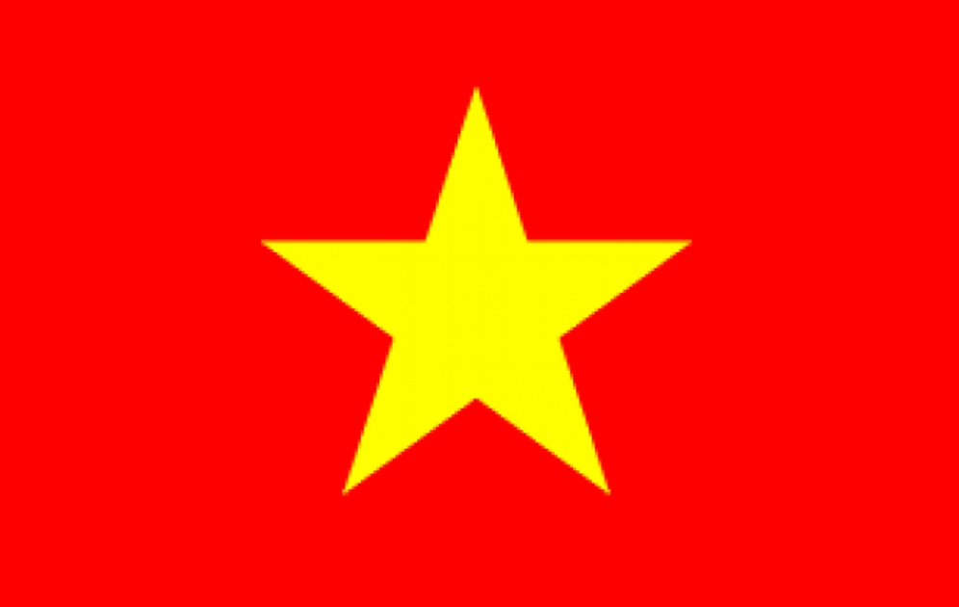
FLAG OF NORTH VIETNAM

Slide 4
FLAG OF SOUTH VIETNAM

Slide 5
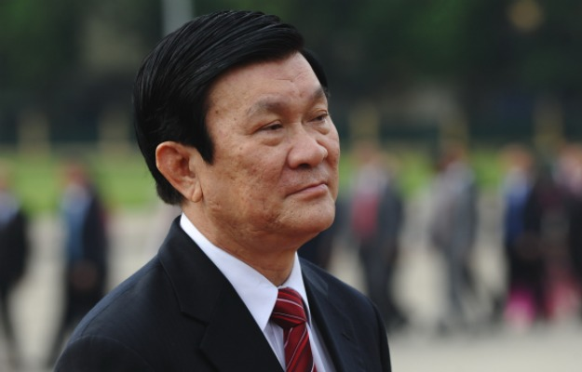
TRUONG TAN SANG

Slide 6
KEY TERMS
CIVIL WAR:
a war between political parties or religions within the same country.
DOMINO THEORY:
a belief that if one country fell to communism, neighboring nations would also fall, like a row of dominoes.

Slide 7
DECADES OF CONFLICTS AND WAR
The people of Vietnam have survived a long period of conflict.
First an alliance of Communists and Nationalists in Vietnam fought against France from 1946 to 1954.
Second a civil war started.

Slide 8
VIETNAM DIVIDED
After the French defeat in 1954, a treaty divided Vietnam into northern and southern parts. Communists controlled the northern half. A non-communist government supported by the United States ruled the South Vietnam.
They treaty said that, eventually an election would be held to reunite the country under one government.

Slide 9
These elections were never held, largely because the United States and Ngo Dinh Diem, the leader of South Vietnam, feared that the Communists might win.
At that time US leaders believed in the domino theory. They believed that the victory of Communism would cause the change to communism in the other countries too, like a row of dominoes.

Slide 10
In 1959, the Communists launched a war to get the South by force.
They were led by Communist leader Ho Chi Minh.
Ho Chi Minh’s forces were called Viet Cong.

Slide 11
AMERICAN INVOLVEMENT IN THE VIETNAM WAR
Communist leader Ho Chi Minh wanted to unite Vietnam under the rule of northern Vietnam.
As the Communists threatened the South Vietnam, the United States took an active role.
At first the US sent thousands of military advisors to help the South Vietnamese. Later hundreds and thousands of American troops arrived.

Slide 12
By 1968 there were more than 500,000 troops in Vietnam.
Vietnam was at war for more than 30 years.
The fighting spread to the neighboring countries like Cambodia and Laos.
North Vietnam sent weapons to their forces in South Vietnam through Laos and Cambodia, due to which United States bombed Cambodia and Laos as well.

Slide 13
S the fight continued many US soldiers died and got injured as a result millions of people in the United States started calling to end the war.
In 1973, United States retreated its soldiers from Vietnam.
More than 3 million Americans served in the Vietnam War and more than 58,000 troops dies in the war and another 150,000 were seriously injured.

Slide 14
AFTER THE VIETNAM WAR
After the United States removed its forces, North Vietnam conquered South Vietnam in 1975.
In 1976 the country reunited under a Communist government.
The war left Vietnam in a very bad situation as more than a million Vietnamese were killed or wounded.
Homes, farms and factories were destroyed.
The Vietnamese were tired but they had a huge struggle of rebuilding ahead of them.

Slide 15
THE VIETNAMESE REBUILD
After the war the communist government took control and with the passage of time they realized that the country is not growing economically.
Vietnam now allows some free enterprise system which has helped many Vietnamese to improve their lives.

Slide 16
Most Vietnamese live in rural areas. In spite of some progress these areas remain poor.
Whole family lives on few hundred dollars a year.
Most houses do not have indoor toilets or running water. Children suffer from a lack of healthy food.
Vietnam is still among the poorest nations in Asia.

Slide 17
REBIRTH IN HO CHI MINH CITY
Vietnam’s biggest success is in building its cities.
Hanoi in the North is the capital, the city of Saigon in the South was renamed after the Communist leader Ho Chi Minh City.
It is the most prosperous city in Vietnam and is the trade center.

Slide 18
Vietnamese who live in big cities enjoy life.
They buy designer clothes and watches, stereo system, video recorders and jewelry.
Many people run restaurants and hotels, buy and sell land, or own factories which help in improving the economy.

Slide 19
ECONOMIC RECOVERY
In 1986, Vietnam’s government started a program to attract the foreign investors.
As a result the economy of Vietnam started growing.
From 1990 to 1997 the economy each year grew about 8 percent.
Agricultural output doubled turning Vietnam into the world’s second largest exporter of rice.

Slide 20
WATER PUPPETS
In Vietnam a type of puppet theater uses a pond for a stage.
Water puppet show started centuries ago.
In these shows, a puppeteer guides wooden figures so that they appear to wade through the water.
The puppets are attached to rods and strings hidden underwater.
Audiences sit at the water’s edge. Stage setting of trees and clouds are also placed on the pond.

Slide 21
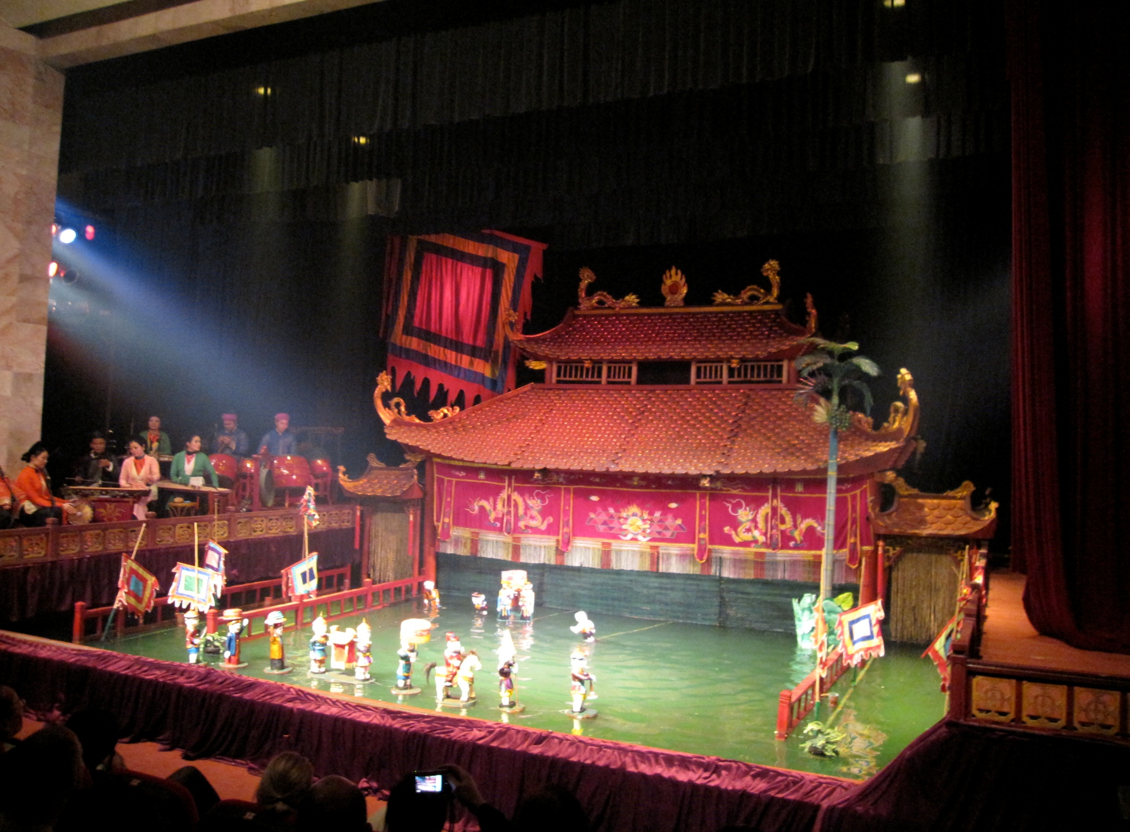

Slide 22
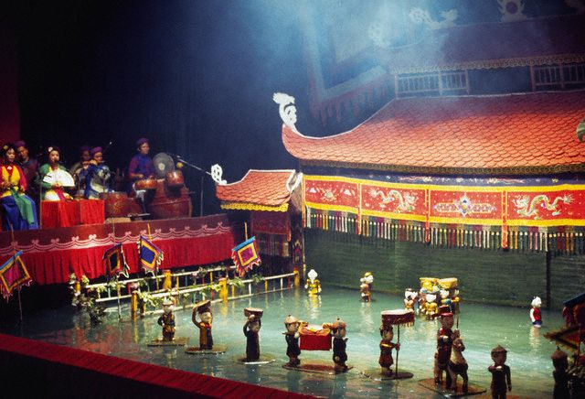

Slide 23
